Slide 1

ANKARA UNIVERSITY
COMPUTER ENGINEERING
Text to Image for Children Books with Stable Diffusion and LoRA
Student Number: 20290310
Student Name SURNAME: Mehmet Bayram Alpay
Supervisor Name SURNAME : Doç. Dr. Gazi Erkan Bostancı
Ankara date

Slide 2

CONTENTS
1. INTRODUCTION
1.1. Problem Definition
1.2. Aim of the Project
2. LITERATURE
3. MATERIAL and METHOD
3.1. Material
3.2. Method
4. EXPERIMENTS
5. CONCLUSION
REFERENCES

Slide 3
1. INTRODUCTION
1.1. Problem Definition
Nowadays, producing long text-based images or images for each page is a very important problem when creating a book, and printing a book without images can make the book boring or difficult to understand. We need this visual content more for children's books. The application we have developed is based on this problem and is an application that provides services to many languages ​​and provides visual development for children's books and thus solves the visual problem.

Slide 4
1. INTRODUCTION
1.2. Aim of the Project
This application aims to produce visual generation technology for children's books using artificial intelligence technology. Books supported by visuals are very important for us to understand the subject and content, and this becomes even more important for children, and if we want to produce a children's book, this application we have developed can contribute to the visual part. Most such applications require English prompts, but our application provides visual production services for books in more than 80 languages, with support from ChatGPT.

Slide 5
2. LITERATURE
The study by Chenghao Wang, and Jeanhun Chung delves into the operating principles and practical applications of Stable Diffusion Web UI in AIdriven image generation. The research highlights the efficiency of the latent diffusion model, which reduces computational and memory costs by operating in a lower-dimensional latent space. It also discusses the user-friendly functionalities provided by the Stable Diffusion Web UI, including text-to-image and image-to-image generation and enhanced control over image details through the Control Net feature. Additionally, the study compares different model types, such as Checkpoint and LoRA, outlining their respective advantages in terms of computational requirements and flexibility in training. This comprehensive analysis underscores the versatility and efficiency of Stable Diffusion Web UI in 2 generating high-quality AI images.
Levin and Belov’s study explores the application of Hypernetwork and LowRank Adaptation (LoRA) in enhancing text-to-image generation using diffusion models. Their research demonstrates that Hypernetworks dynamically adjust model parameters based on input text, providing greater flexibility and performance, while LoRA efficiently adapts the primary model style without requiring extensive retraining.
Wu et al. (2023) introduce EasyPhoto, a novel WebUI plugin designed to generate AI portraits by leveraging Stable Diffusion models. EasyPhoto finetunes the diffusion model using LoRA (Low-Rank Adaptation) with user-specific images to create accurate digital doppelgangers. By incorporating reinforcement learning and ControlNet, the plugin ensures high fidelity and visual consistency in the generated images. This approach addresses common issues like identity loss and boundary artifacts, making EasyPhoto a robust tool for personalized AI photo generation.

Slide 6
3. MATERIAL and METHOD
3.0. What is stable diffusion?
Stable Diffusion is an artificial intelligence method developed based on diffusion models, a technique used in image processing and computer vision. Diffusion models work by progressively cleaning or enhancing an image with random noise added to it. This process is repeated until a clean image is obtained from noise.
3.1. What is LoRA models?
LoRA (Low-Rank Adaptation) Models are fine-tuning of large-scale language models (LLMs) to adapt them to specific tasks or data sets. It is a technique used to. LoRA aims to improve performance faster and more efficiently by preserving the basic structure of the model and optimizing only certain parameters.

Slide 7
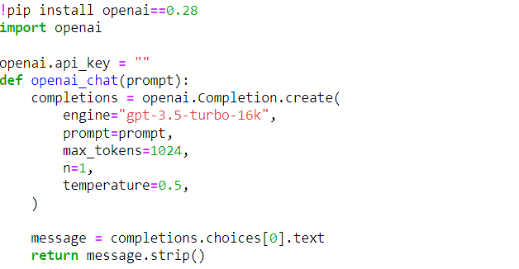
3. MATERIAL and METHOD
3.2. Method
We provide ChatGPT connection in our code. ChatGPT is an LLM that operates and responds in more than 80 languages ​​and provides a wide range of opportunities in terms of using ready-made templates. That's why we will use ChatGPT and generate prompts with ready-made templates, and we make the ChatGPT connection in the image below.

Slide 8
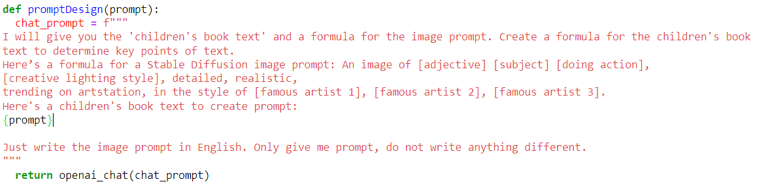
3. MATERIAL and METHOD
3.2. Method
In the project, we produce prompts for our project, regardless of languages, by using ChatGPT and ready-made templates. The code below is a ready prompt entry for ChatGPT, and chat_prompt is prepared with the prompt entered by the user and given as a prompt to ChatGPT.

Slide 9
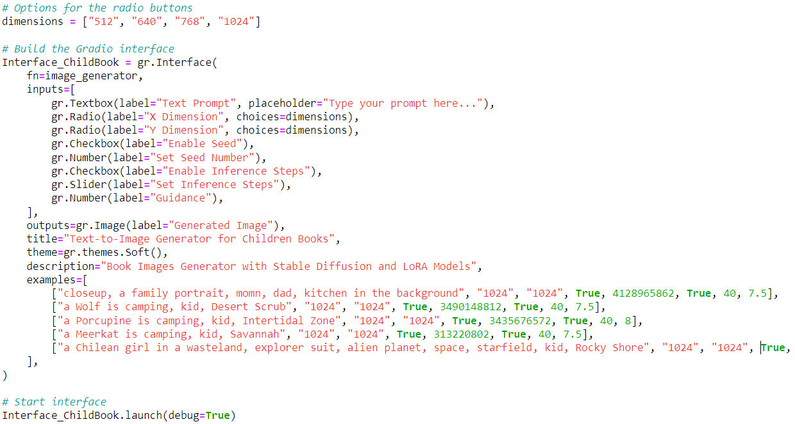
3. MATERIAL and METHOD
3.2. Method
I made a user interactive application using the gradio library for the user-system interface. Here, the user can produce the desired image in a short time by adjusting the image in the desired size for the book he wants and making choices for some visual improvements. The image below includes the adjustments made for the interface.

Slide 10
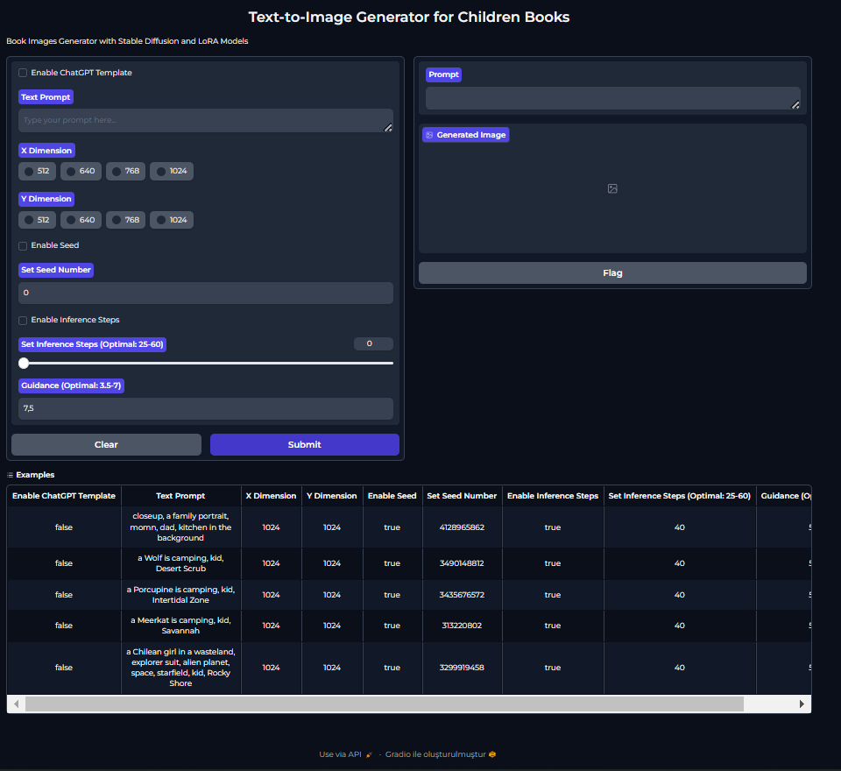
4. EXPERIMENTS
The application interface experience prepared with Gradio can be presented clearly.

Slide 11
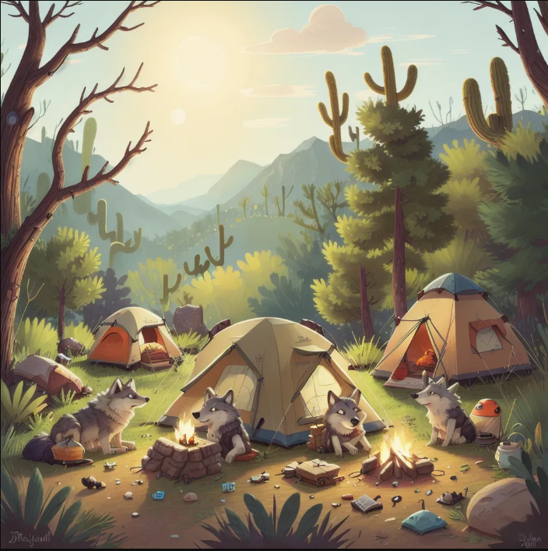
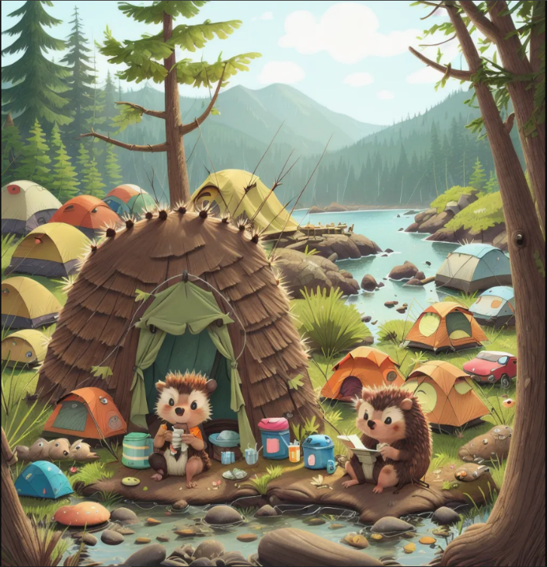
4. EXPERIMENTS
Some images produced by our model for children's book sample prompts are shown below.

Slide 12
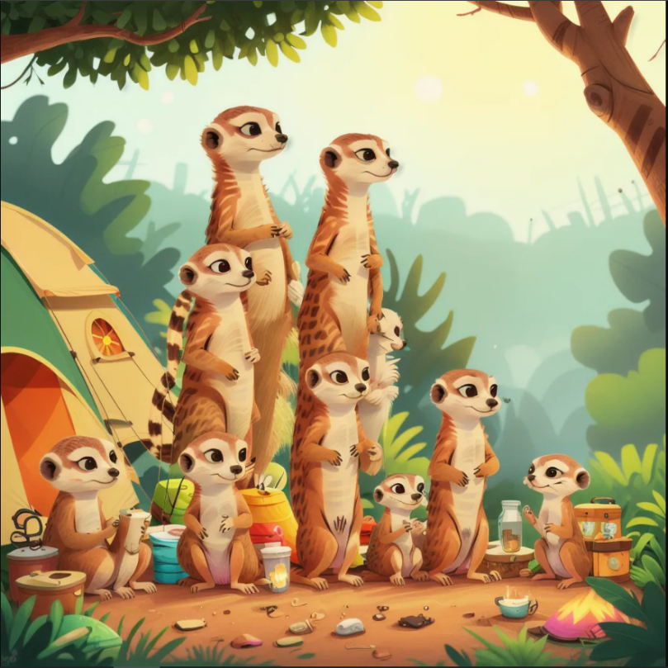
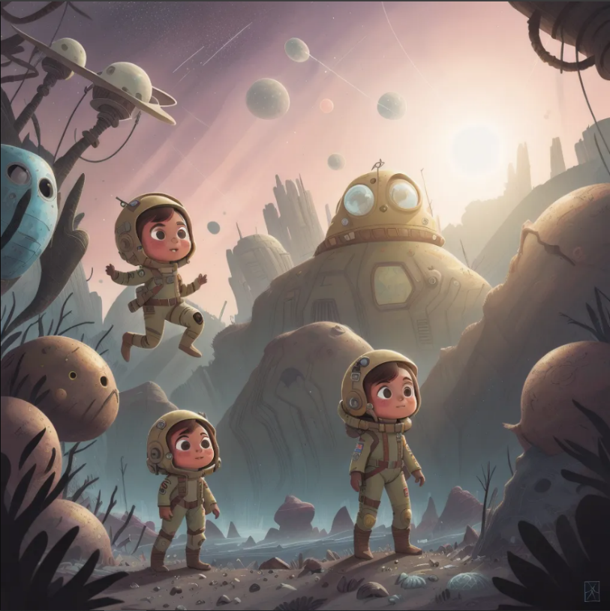
4. EXPERIMENTS
While producing images with our model, it was a common problem that it produced more than one character depending on the size.

Slide 13
5. CONCLUSION
- Result
Our project currently works interactively, but it is based on the SD 1.5 model and other models can also be tried. Since this is an application created by the interaction of Google Colab and HuggingFace, the deficiencies provided by these sites may have prevented the development of the model. People who have quality hardware can directly set up their own stable diffusion computers and try the models for children's books, which can help them access more features, but our application has also been a useful application for people who currently have hardware and language problems.

Slide 14
REFERENCES
[1] Wang, Jianfeng, et al. ”Git: A generative image-to-text transformer for vision and language.” arXiv preprint arXiv:2205.14100 (2022).
[2] Hu, Edward J., et al. ”Lora: Low-rank adaptation of large language models.” arXiv preprint arXiv:2106.09685 (2021).
[3] Wang, Lufeng, et al. ”Constructing a personalized AI assistant for shear wall layout using Stable Diffusion.” arXiv preprint arXiv:2305.10830 (2023).
[4] Wang, Chenghao, and Jeanhun Chung. ”Research on AI Painting Generation Technology Based on the [Stable Diffusion].” International journal of advanced smart convergence 12.2 (2023): 90-95.
[5] Datta, Siddhartha, et al. ”Prompt expansion for adaptive text-to-image generation.” arXiv preprint arXiv:2312.16720 (2023).
[6] Wu, Ziheng, et al. ”EasyPhoto: Your Smart AI Photo Generator.” arXiv preprint arXiv:2310.04672 (2023).
[7] Luo, Simian, et al. ”Lcm-lora: A universal stable-diffusion acceleration module.” arXiv preprint arXiv:2311.05556 (2023).

Slide 15

ANKARA UNIVERSITY
COMPUTER ENGINEERING
THANK YOU
Student Number: 20290310
Student Name SURNAME: Mehmet Bayram Alpay
Supervisor Name SURNAME : Doç. Dr. Gazi Erkan Bostancı

